Slide 1
Azure deployment planner
Mason Adams – Cloud Migration Engineer

Slide 2
AGENDA
Azure Site Recovery (ASR) Deployment Planner Overview
How 10th Magnitude utilizes ASR Deployment Planner
Useful links to learn more
Deployment Planner output demo

Slide 3
ASR Deployment Planner Overview

Slide 4
Deployment Planner
Planning for replication needs
  Deployment planner works for both Hyper-V and VMWare environments
  Provides a VM eligibility assessment based on disk sizes, churn, OS version, etc.
  Estimates Bandwidth needed to reach the desired Recovery Point Objective and the impact of a lower bandwidth
  Estimates Azure and on-prem infrastructure needs, such as number and type of storage accounts, storage type for each VM, size of each VM, and number of configuration servers.
  Estimates costs associated with disaster recovery such as compute, storage, network, and license prices per VM.

Slide 5


Deployment Planner
Command line tool that is installed on each Hyper-V host or cluster, or on each vSphere server to assess all VMs associated with each.
3 main phases: Get VM List, Profiling, and Report Generation.
Outputs an Excel document

Slide 6
How 10th Magnitude utilizes ASR Deployment Planner

Slide 7
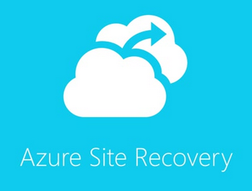
Use cases for deployment planner
Used by the CMC to determine ASR and Azure landing zone requirements
Can also be used to give VMs an appropriate size in Azure
The output can determine groups of servers to replicate due to bandwidth concerns
Azure Migrate Assessment produces a similar report, but deployment planner provides additional information

Slide 8
Links for more information

Slide 9
Learn more
ASR Deployment Planner
  Hyper-V https://docs.microsoft.com/en-us/azure/site-recovery/hyper-v-deployment-planner-overview
  VMWare https://docs.microsoft.com/en-us/azure/site-recovery/site-recovery-deployment-planner

